Slide 1

On the Road
Infrastructure and it’s role in Christianity

Slide 2
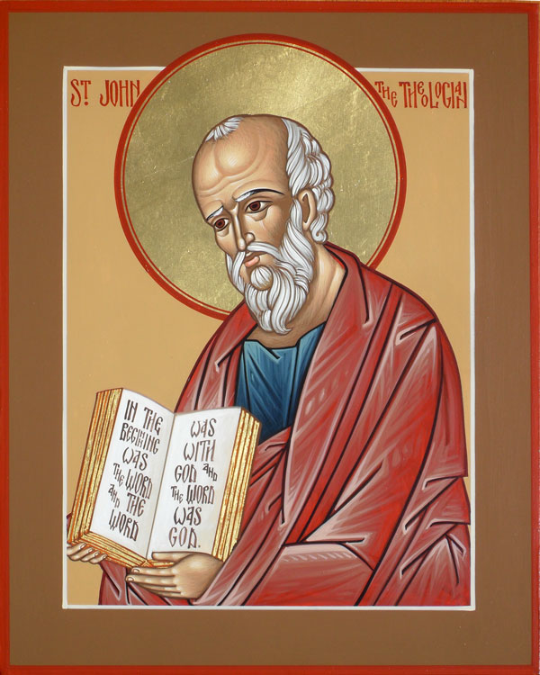
John 14:1-14
Notes:
The Road
14 ¹⁻⁴ “Don’t let this throw you. You trust God, don’t you? Trust me. There is plenty of room for you in my Father’s home. If that weren’t so, would I have told you that I’m on my way to get a room ready for you? And if I’m on my way to get your room ready, I’ll come back and get you so you can live where I live. And you already know the road I’m taking.”
⁵ Thomas said, “Master, we have no idea where you’re going. How do you expect us to know the road?”
⁶⁻⁷ Jesus said, “I am the Road, also the Truth, also the Life. No one gets to the Father apart from me. If you really knew me, you would know my Father as well. From now on, you do know him. You’ve even seen him!”
⁸ Philip said, “Master, show us the Father; then we’ll be content.”
⁹⁻¹⁰ “You’ve been with me all this time, Philip, and you still don’t understand? To see me is to see the Father. So how can you ask, ‘Where is the Father?’ Don’t you believe that I am in the Father and the Father is in me? The words that I speak to you aren’t mere words. I don’t just make them up on my own. The Father who resides in me crafts each word into a divine act.
¹¹⁻¹⁴ “Believe me: I am in my Father and my Father is in me. If you can’t believe that, believe what you see—these works. The person who trusts me will not only do what I’m doing but even greater things, because I, on my way to the Father, am giving you the same work to do that I’ve been doing. You can count on it. From now on, whatever you request along the lines of who I am and what I am doing, I’ll do it. That’s how the Father will be seen for who he is in the Son. I mean it. Whatever you request in this way, I’ll do.

Slide 3

Imagine heaven
Notes:
Just a quick exercise. What do you imagine heaven is like?
Draw a picture to make it more concrete. Does it have rooms? Malls? Really think about the physical or non-physical nature

Slide 4
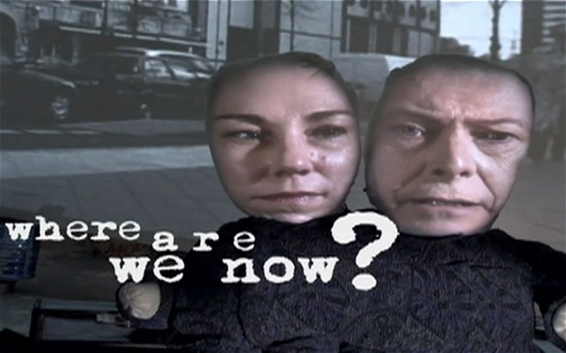
Where are we in the story?
Notes:
Jesus has just had the last supper. Tells him that he will not be with him much longer.
How do you think the Disciples react?
Do you think this is after the fact construction or accurate depiction?

Slide 5
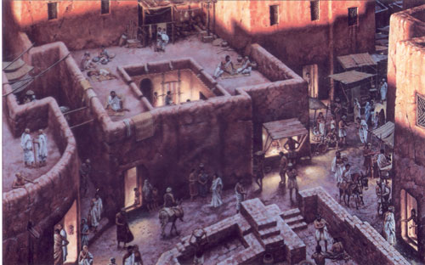
Trust me, there’s (a) room
Notes:
“Don’t let this throw you. You trust God, don’t you? Trust me. There is plenty of room for you in my Father’s home.
We are starting to see physical metaphors. Now we have people who stay in rooms in a house.
The housing metaphors change through the chapters. What kind of dwellings were talked about in the Bible earlier?
Tents
Cities
Temples
Pyramids

Slide 6
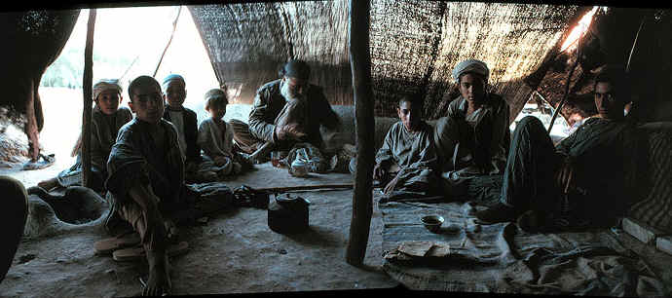
Tents
Notes:
http://www.bible-architecture.info/Housing.htm
Tents were large and 2 separate sections.
Used by clans and tribes. Herders.
Polygamy – each wive had tent. Raised her kids there. Husband went to her when desired.

Slide 7
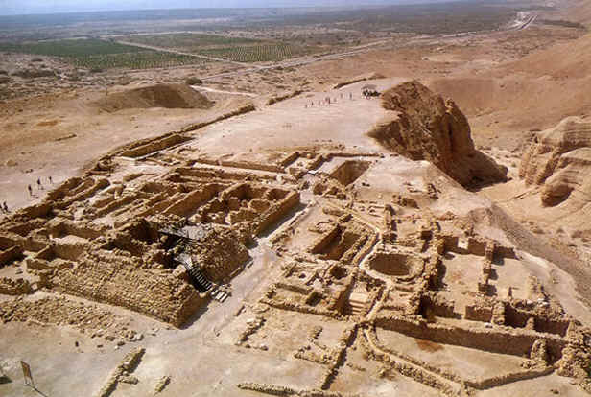
Cities
http://www.bible-architecture.info/images/houses3.jpg
Notes:
Villages were inside of walled structure.
Until the beginning of the 1st millennium BC, the biblical lands were a place of city states, independent of each other and, if we can judge from the amount of attention lavished on the walls and fortifications, often warring with each other.
Needed to take care of crops and prepare meals.

Slide 8
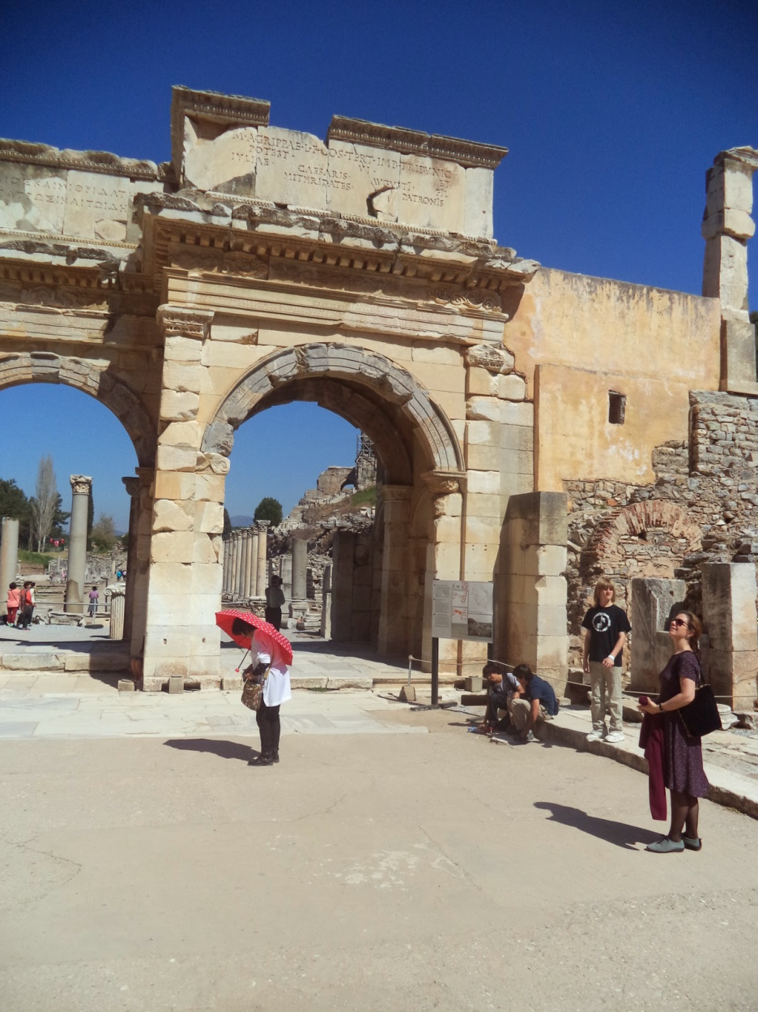
Public Buildings
Notes:
Large public buildings were large in size but the number of rooms didn’t grow.
There were large common areas.
This is Ephesus.

Slide 9
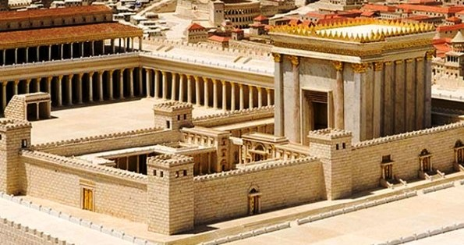
Temples
Notes:
Herod’s temple. Once again it has large open places.
There is a royal “suite” but mostly walking around place.s

Slide 10
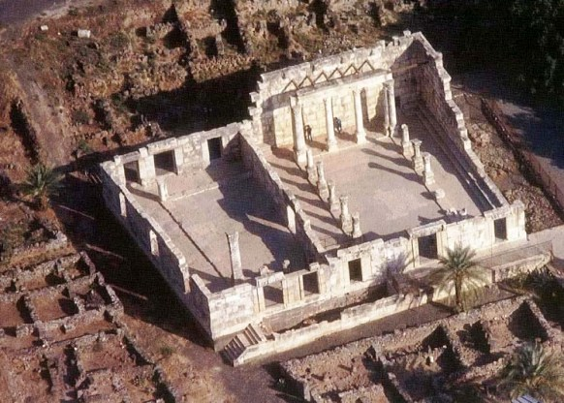
Synagogues
Notes:
Synagogues are the buildings that morphed into Churches.
These are places where Jews would congregate when not a high holy day.
There were no churches in Jesus’ day.
The word that is translated into Church is ekklesia
This means literally peoplecalled out from the world and to God

Slide 11
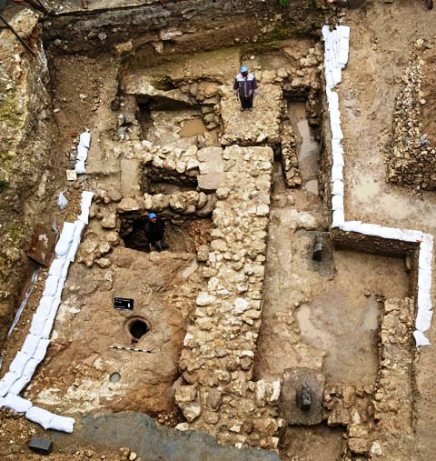
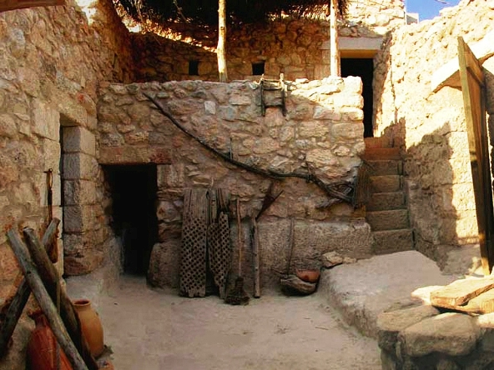
So what would Jesus lived in?
Notes:
Modern-day excavations in Nazareth: the houses ordinary people lived in usually had rough stone foundations and mud-brick walls
Rooms were limited by the size of the beams due to materials.
Would include a mikveh ->pool of clean rainwater for ritual cleansing
Stone base oven
Grinding place
Covered area where people could talk
Covered area for animals lived close to humans
Roof for drying materials

Slide 12
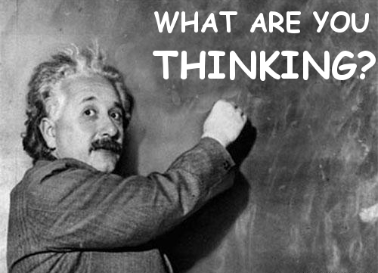
What did the disciples think that Jesus’ house would be?
Notes:
Do you think it would be like the big public buildings or a city like the one they lived in?
Do you think this idea of what buildings were possible might have made them worried?
If that weren’t so, would I have told you that I’m on my way to get a room ready for you? And if I’m on my way to get your room ready, I’ll come back and get you so you can live where I live. And you already know the road I’m taking.”

Slide 13
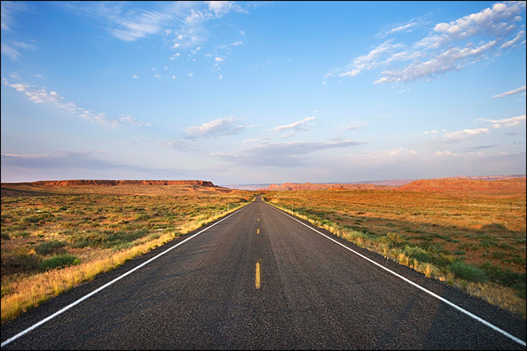
I am the way ^{road}
Notes:
Way is not the best translation. It is used most places as road.
101 occurrences in new testament. Most of them are normally translated as road.
Examples:
Acts 8:36 N-AFS along the road they came
Luke 8:5 N-AFS beside the road, and it was trampled under foot
Prepare the “road” or way?
http://biblehub.com/greek/3598.htm

Slide 14

Only one way?
Notes:
Jesus is supposed to have said there is only 1 way to the father?
What do you think about that?

Slide 15
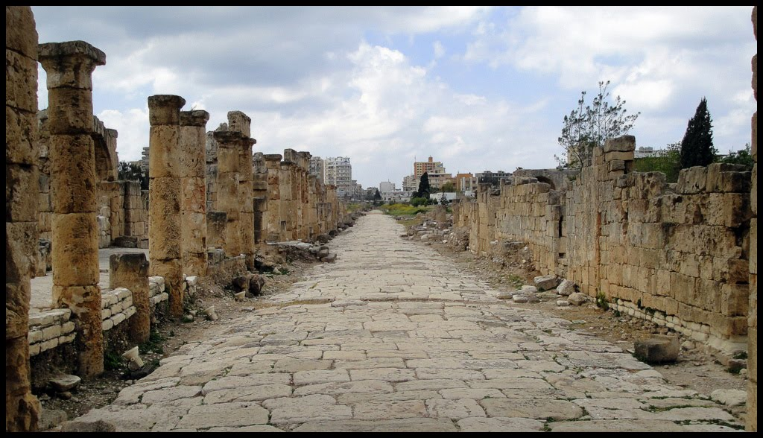
How will we know the road?
Notes:
Written at the end of 1st Century.
During the great revolt (66-74 AD) the Romans constructed new roads to make their long supply lines more efficient.
Their mobilization of the army required better roads than were constructed previously.
How did these roads effect the making of the Bible?

Slide 16
Road Trip
Notes:
Paul, a roman citizen, traveled these roads to spread the Gospel.
Peter also traveled along these roads.
Without these roads, the ideas could not have spread as far or wide as they did.
The religions that scale have infrastruture that scales.

Slide 17
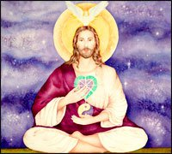
Zen Jesus
Notes:
^{Jesus goes all Zen koan on} them. Explain a koan.
I am the Father =the Father is me.
Having trouble believe in the things I have done
Crafts into a divine act
But I am on the road to my father
⁹⁻¹⁰ “You’ve been with me all this time, Philip, and you still don’t understand? To see me is to see the Father. So how can you ask, ‘Where is the Father?’ Don’t you believe that I am in the Father and the Father is in me? The words that I speak to you aren’t mere words. I don’t just make them up on my own. The Father who resides in me crafts each word into a divine act.
¹¹⁻¹⁴ “Believe me: I am in my Father and my Father is in me. If you can’t believe that, believe what you see—these works. The person who trusts me will not only do what I’m doing but even greater things, because I, on my way to the Father, am giving you the same work to do that I’ve been doing. You can count on it. From now on, whatever you request along the lines of who I am and what I am doing, I’ll do it. That’s how the Father will be seen for who he is in the Son. I mean it. Whatever you request in this way, I’ll do.

Slide 18
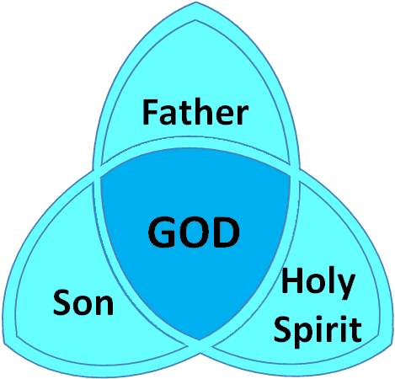
Trinity
Notes:
What is the trinity?
Does it make sense?
Common metaphors-ice, water and steam.

Slide 19
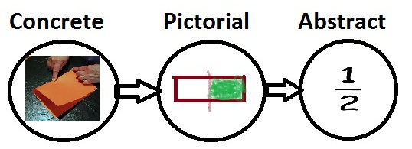
From the concrete to abstract
Notes:
We went from talking about Jesus leaving on a road to a very abstract concept of trinity.
That is why most people believe the whole thing is abstract and use “the way” which is a more abstract idea.
My interpretation is that the disciples were being too literal and Jesus uses ideas to try and break them of this literalism.
What do you think?

